Slide 1
User Management System
Presented by
Mahir Mahbub
Lecturer, Dept. of IRE,
Bangabandhu Sheikh Mujibur Rahman Digital University

Slide 2
Features
Creating Super Admin from System
Create Admin by Super Admin
Register Admin
Admin Account approval by Super Admin
All User Account Verify by Email and OTP
All User Reset Password by Email and OTP
All User Sign in (Bearer Jwt Token).
OTP is expired in 5 minutes.
Password Reset/Verification Link is expired in 30 minutes.

Slide 3
Technology
Backend Web Framework: Django REST and Django Web Framework
Auth: Json Web Token(JWT) Bearer
Follow open standard (RFC 7519).
Use for authorization
Includes role and permissions in claims.
Containerization: Docker(esp. Docker-compose)
SMTP Service: Mailgun
OTP Service: Twillo
Database: SQLite for Development, Postgres for Deployment
API Documentation: OpenAPI Swagger

Slide 4
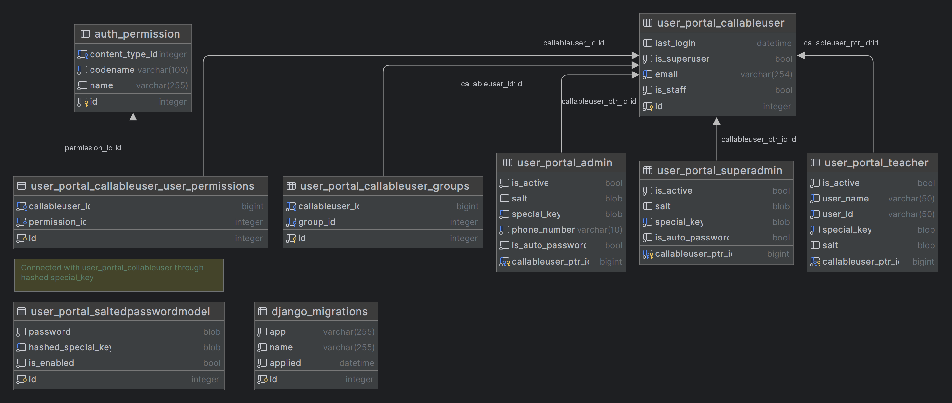
Database Description

Slide 5
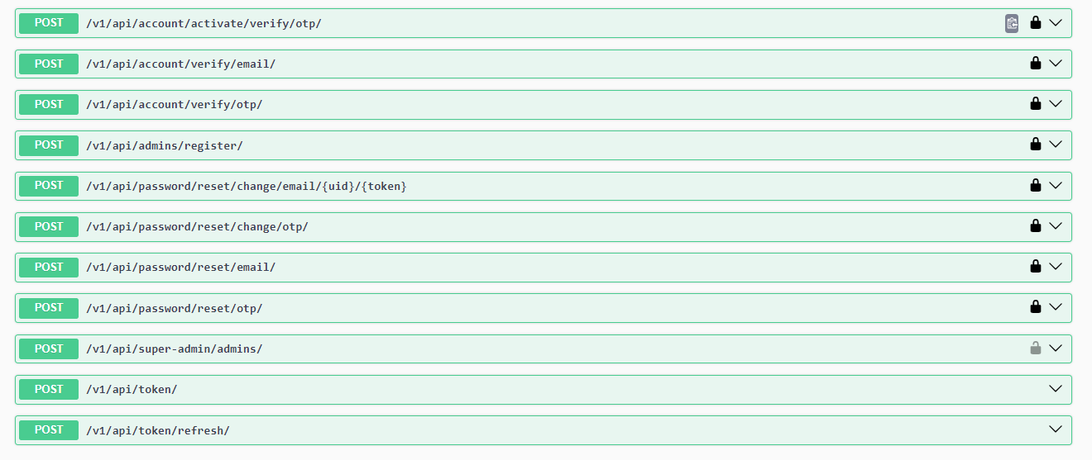
RESTAPI Design

Slide 6
Database Description(Contd.)
Separate Password Table.
Salt is stored in Child User tables to encrypt special key for finding the password.
Used bcrypt algorithm for hashing the password and special key.
The salt is incorporated into the hash for bcrypt.
Permissions maintained through a master table.

Slide 7
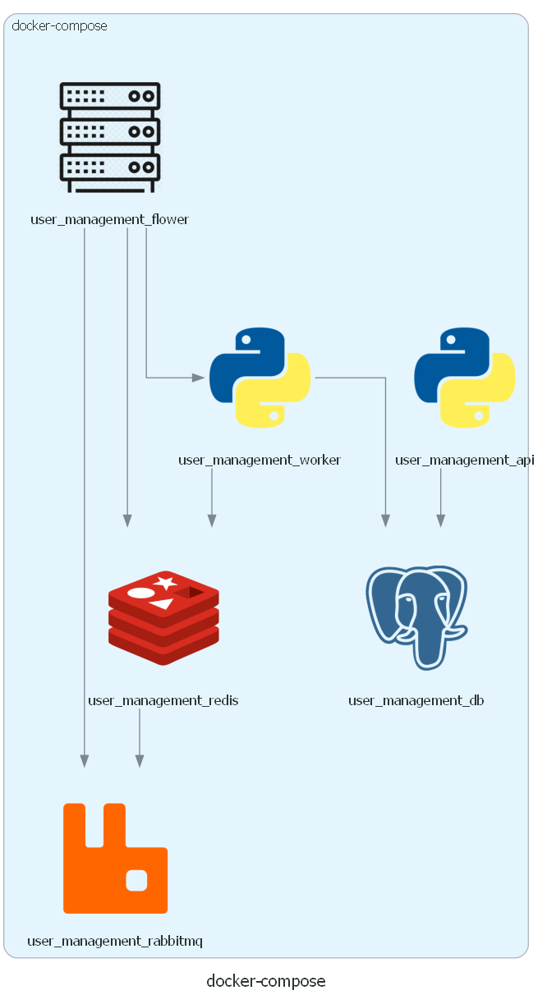
Service Aritechture

Slide 8
Implementation
See source.
In the next slides, we will see the flow of register, verification and reset password, login for user.

Slide 9
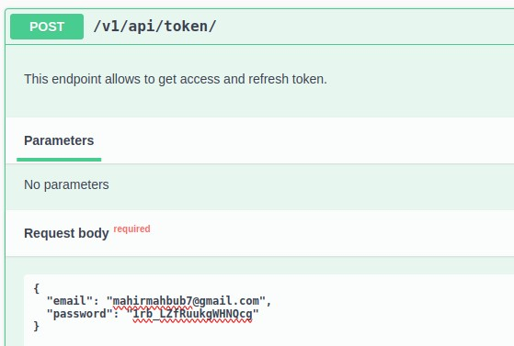
Workflow (Register an Admin by Super Admin)
Create Super User
Generate Access Token

Slide 10
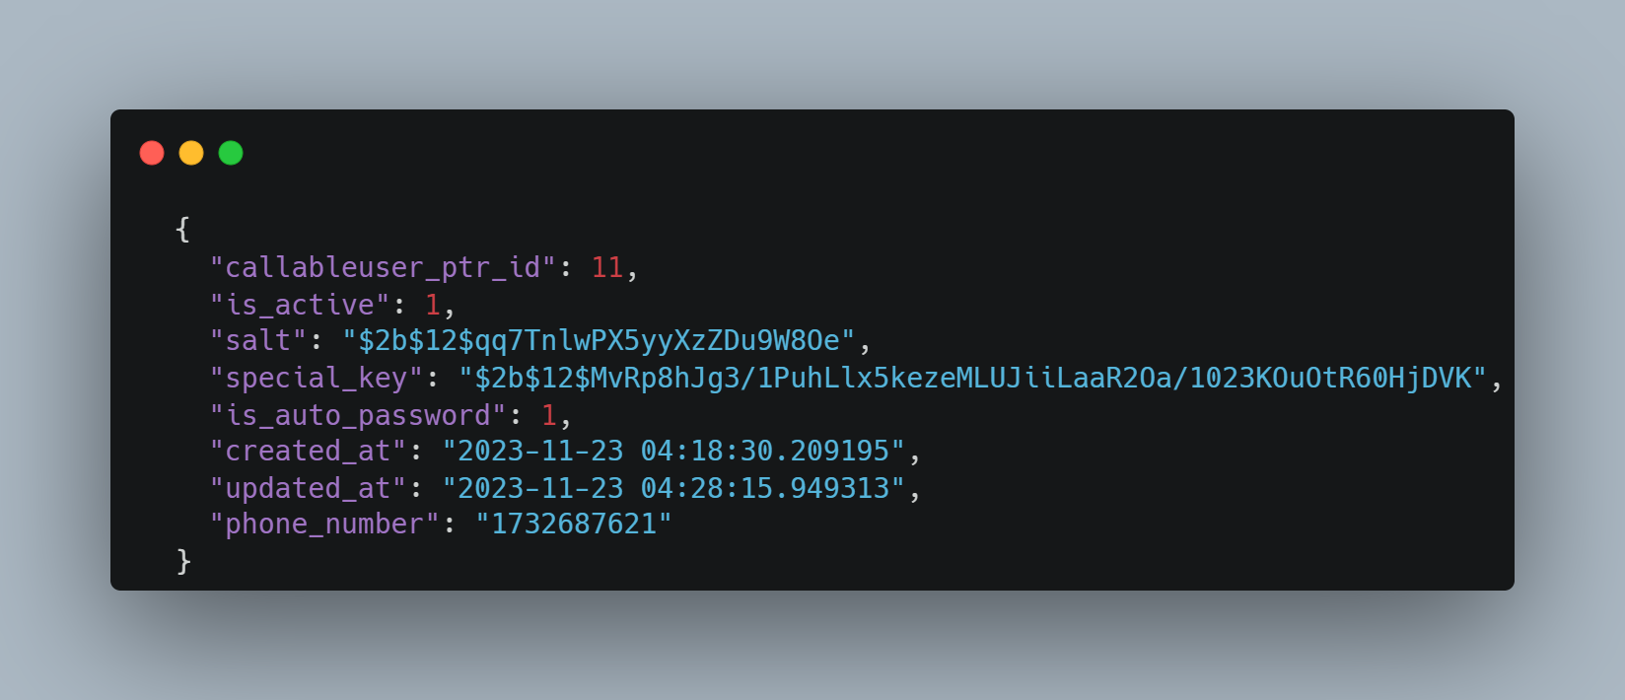
Workflow (Contd.)
Super Admin instance in DB after creation

Slide 11
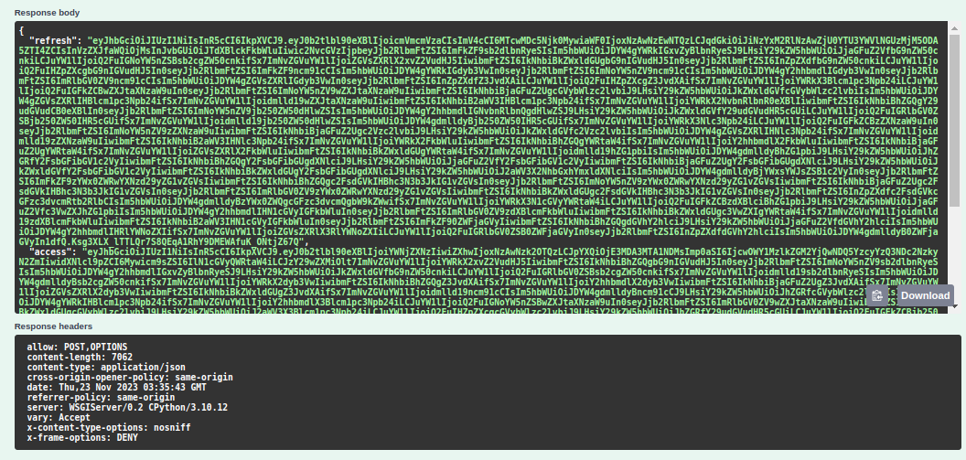
Workflow (Contd.)
Generated Token View
For the decoded version of this token, Visit here

Slide 12
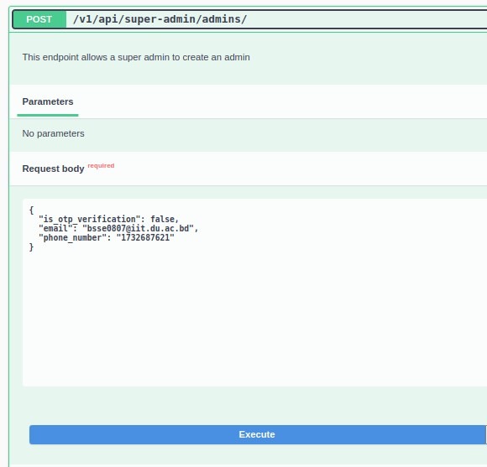
Workflow (Contd.)
Request Super Admin creating an admin

Slide 13
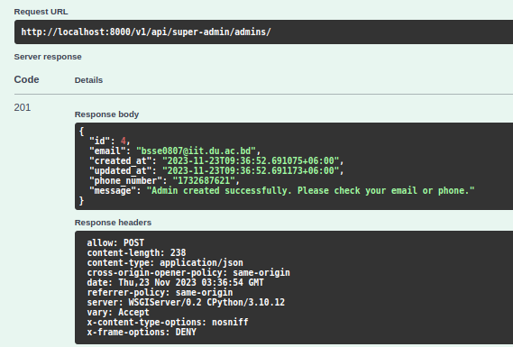

Workflow (Contd.)
Response of Super Admin creating an admin
User receive an OTP

Slide 14
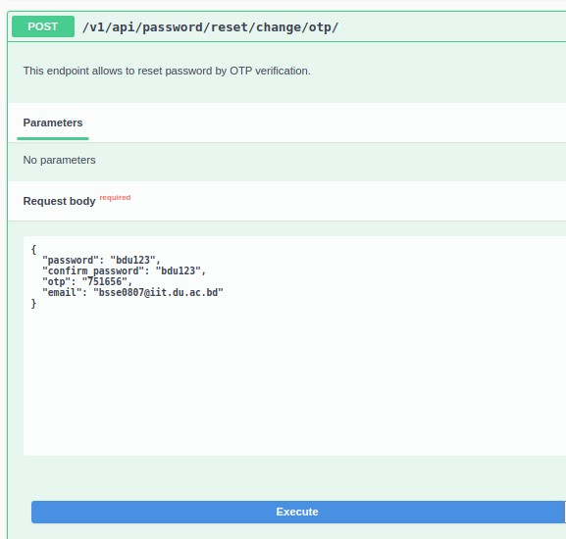
Workflow (Contd.)
Request for reset the default password.

Slide 15
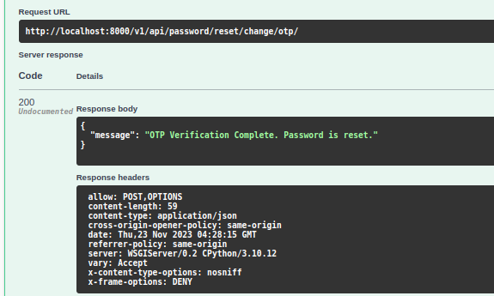
Workflow (Contd.)
Response for reset the default password.

Slide 16
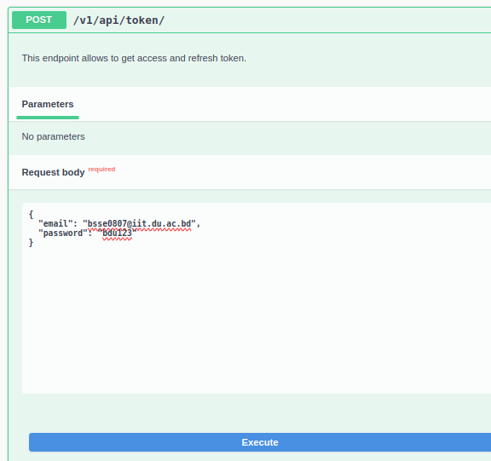
Workflow (Contd.)
Request for Admin login with the changed password

Slide 17
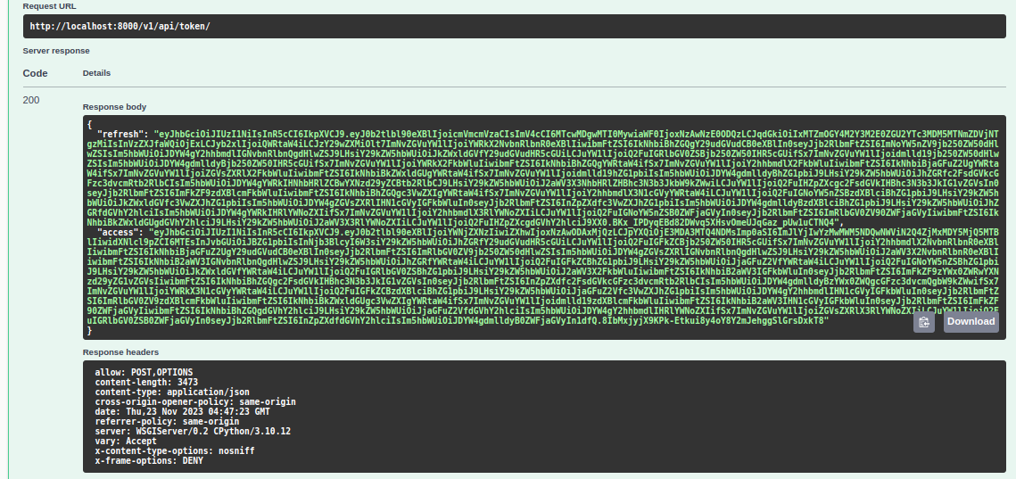
Workflow (Contd.)
Request for Admin login with the changed password
For the decoded view of the token, Visit here

Slide 18
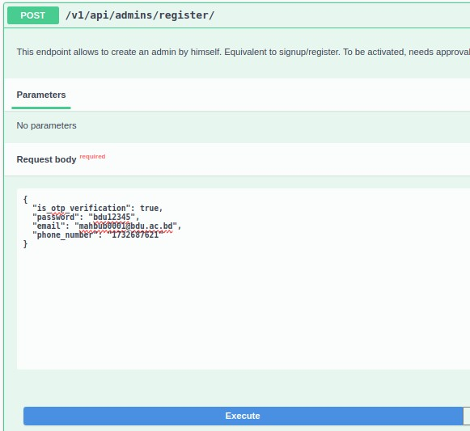
Workflow (Register an Admin by himself)
Request for admin registration

Slide 19
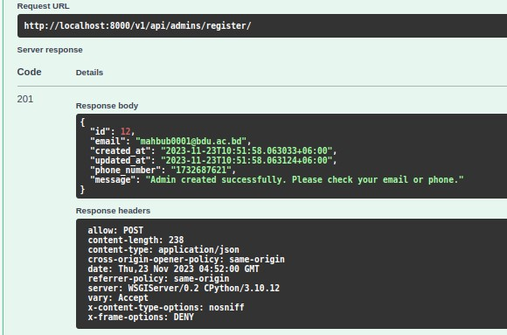
Workflow (Contd.)
Response for admin registration

Slide 20
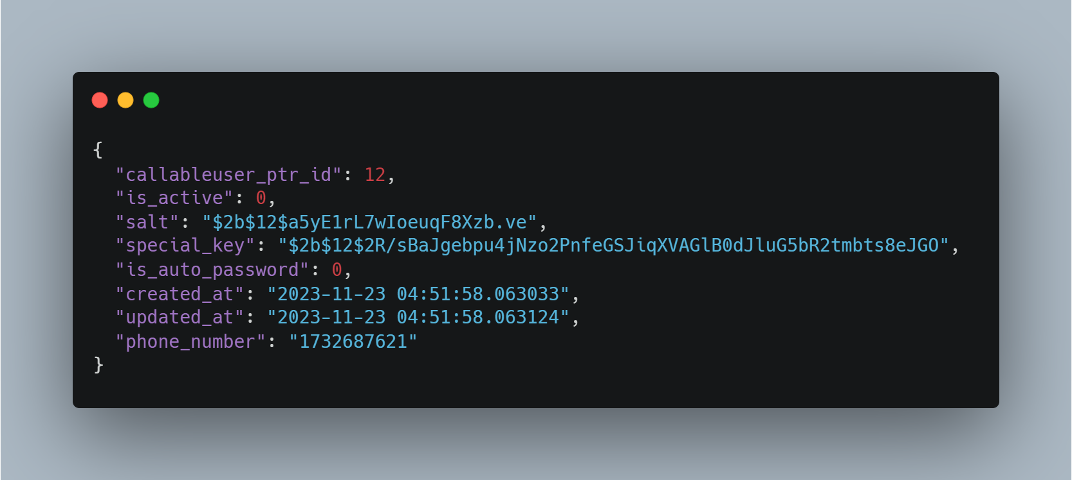
Workflow (Contd.)
User instance in DB after register

Slide 21
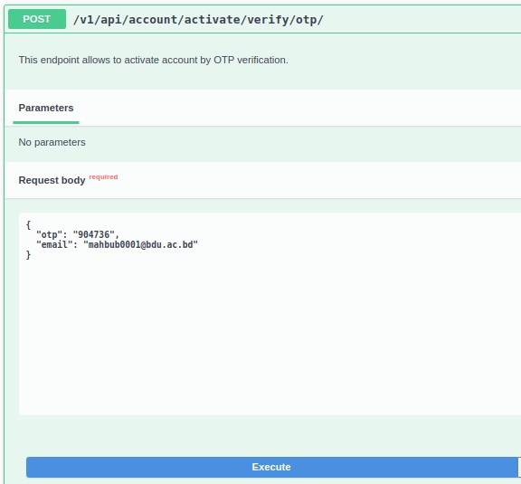
Workflow (Contd.)
Request for activating the registered user.

Slide 22
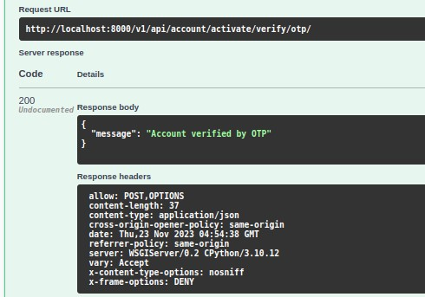
Workflow (Contd.)
Response for activating the registered user.

Slide 23
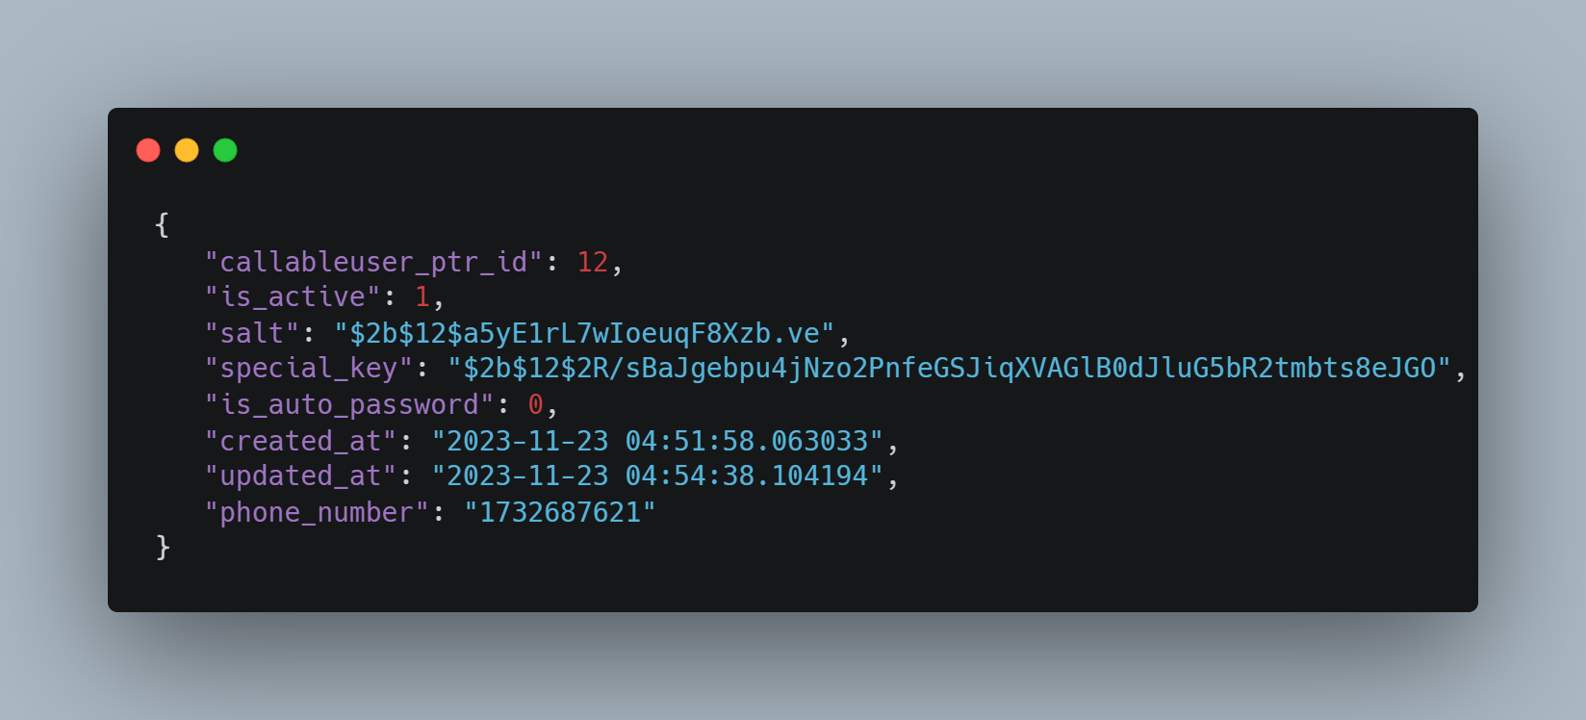
Workflow (Contd.)
User instance in DB after verify

Slide 24
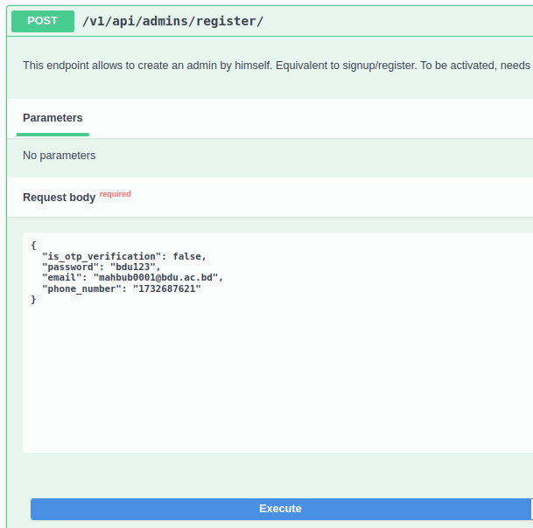
Workflow(Register User by himself with email verification)

Slide 25
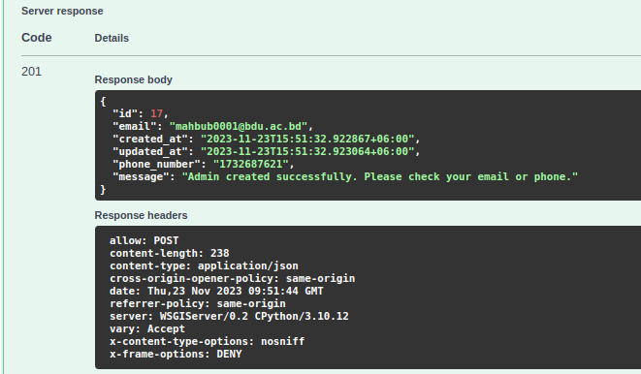
Workflow (Contd.)

Slide 26
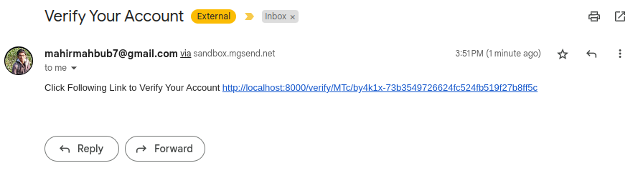
Workflow (Contd.)

Slide 27
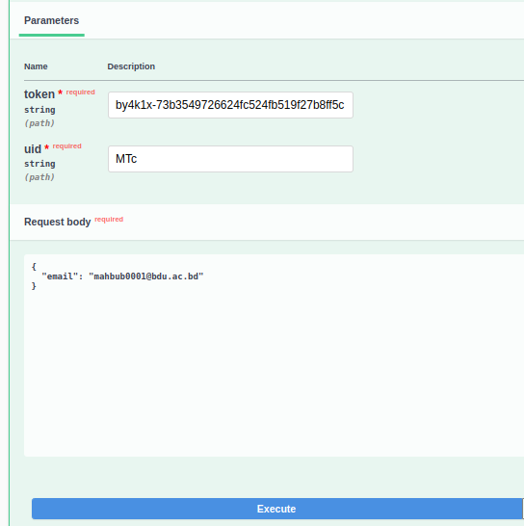
Workflow (Contd.)

Slide 28
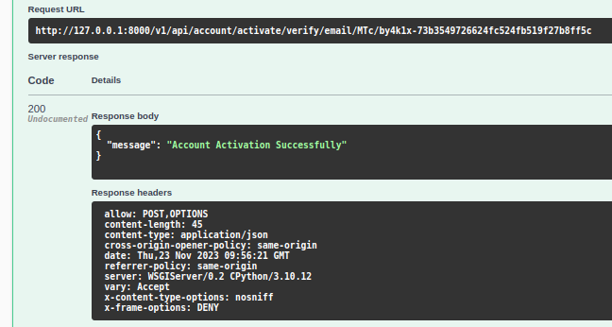
Workflow (Contd.)

Slide 29
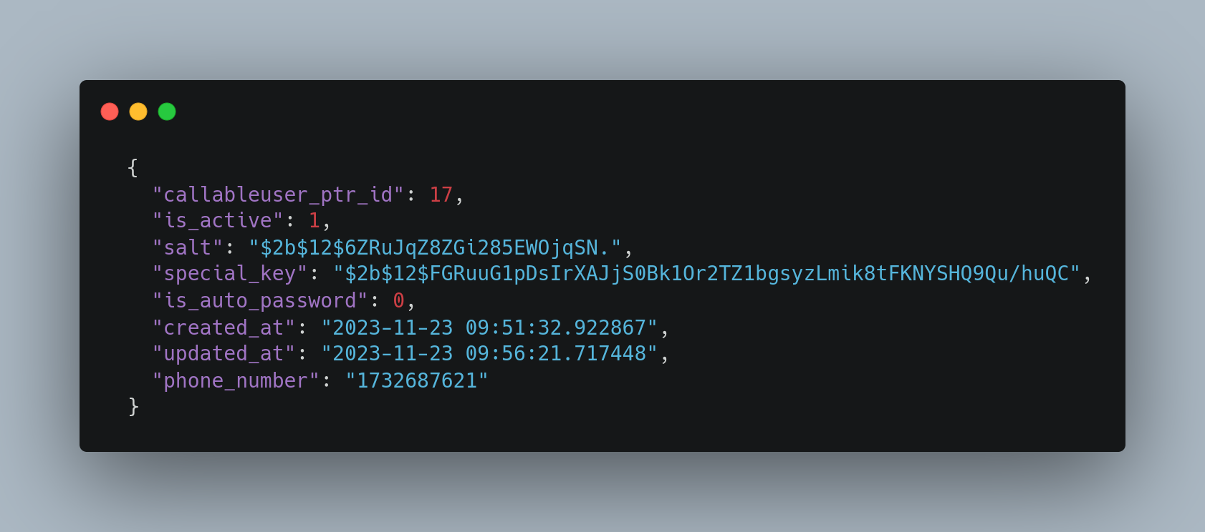
Admin User Instance after Activation

Slide 30
Conclusion
The process is same for create Admin by Super Admin by email verification and Change password by email verification.
The other functionalities will be shown in live demo.
Q/A Session.

